Slide 1
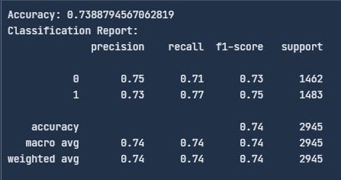
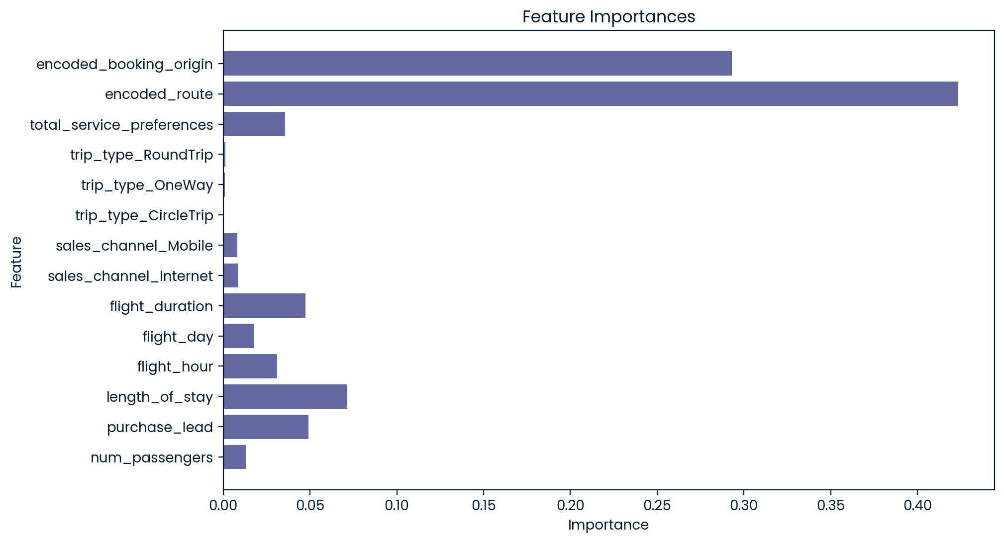
Model Evaluation
Key Insights
Correlation Insights:
Encoded Route: 0.48 (strongest positive correlation)
Encoded Booking Origin: 0.42 (moderate positive correlation)
Total Service Preferences: 0.06 (weak positive correlation)
Flight Duration: -0.15 (weak negative correlation)
Feature Importance Plot
Key Recommendations
Optimize Routes and Origins
Improve Long Flight Experience
Targeted Marketing Campaigns
Enhance Service Offerings

